Slide 1
Installation & Wiring Guide
Fingerprint/Card Terminal
UBio-X Slim V1.0
Doc. Ver. : V1.1
JAN.17, 2020
R&D Center
Union Community Co., Ltd.

Slide 2
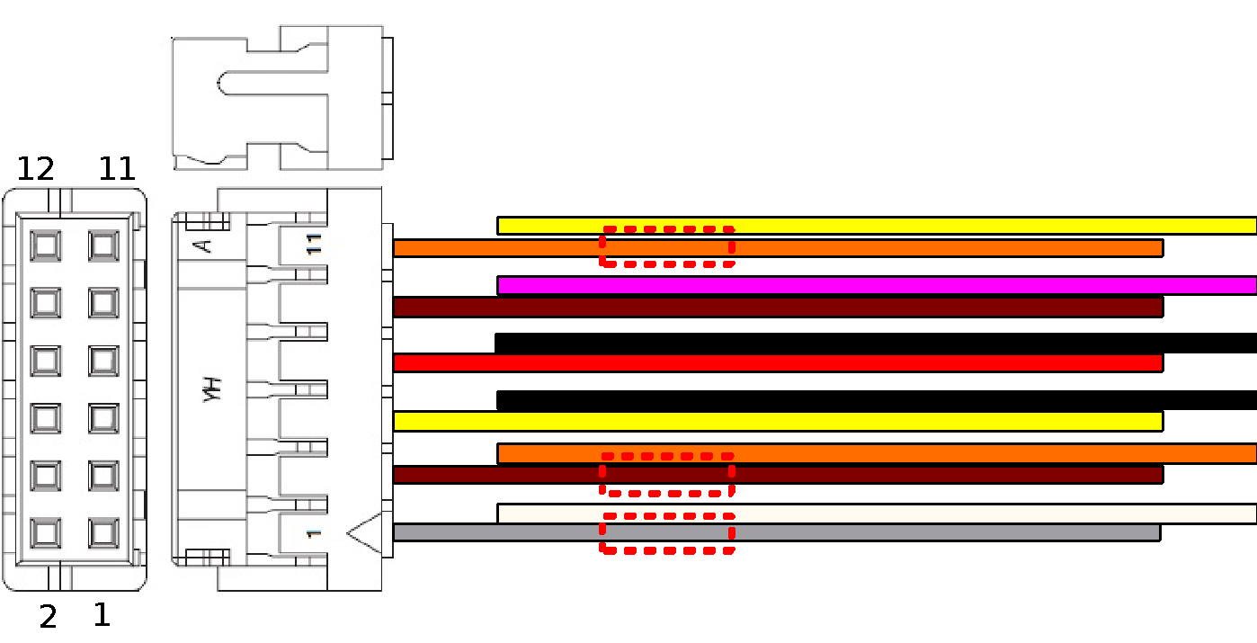
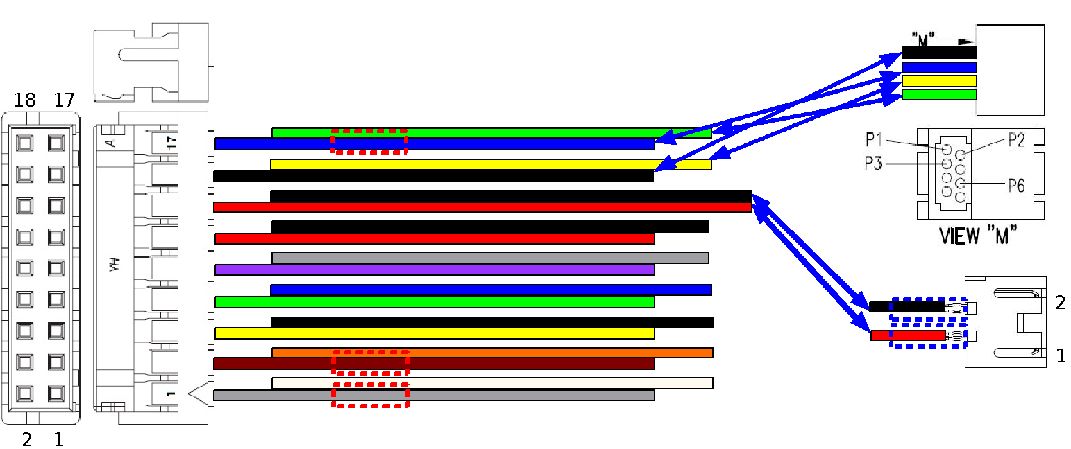
1. Cable descriptions
1.1. Main Cable ( 18pin )
18pin Main Cable
1. Gray : Lock1 Com : L1C
2. White : Lock1 NO : L1NO
3. Brown : Lock1 NC : L1NC
4. Orange : Exit : EXT
5. Yellow : Monitor : DM0
6. Black : Ground : GND
7. Green : RS485A : R4A
8. Blue : RS485B : R4B
9. Violet : RS232TXD : R2T
10. Gray : RS232 RXD : R2R
11. Red : DC12V Out : 12V
12. Black : Ground : GND
13. Red : DC12V IN : 12V
14. Black : Ground : GND
15. Black : Ethernet TXP
16. Yellow : Ethernet RXP
17. Blue : Ethernet TXN
18. Green : Ethernet RXN
** Pin1 & Pin 11 Shorted
1.2. Sub Cable ( 12pin )
12pin Sub Cable
1. Gray : Lock2 Com : L2C
2. White : Lock2 NO : L2NO
3. Brown : Lock2 NC : L2NC
4. Orange : Aux IN1 : AIN1
5. Yellow : Aux IN2 : AIN2
6. Black : Ground : GND
7. Red : 5V Out : 5V
8. Black : Ground : GND
9. Brown : Wiegand IN 0 : Wi0
10. Pink : Wiegand IN 1 : Wi1
11. Orange : Wiegand Out 0 : WO0
12. Yellow : Wiegand Out 1 : WO1

Slide 3
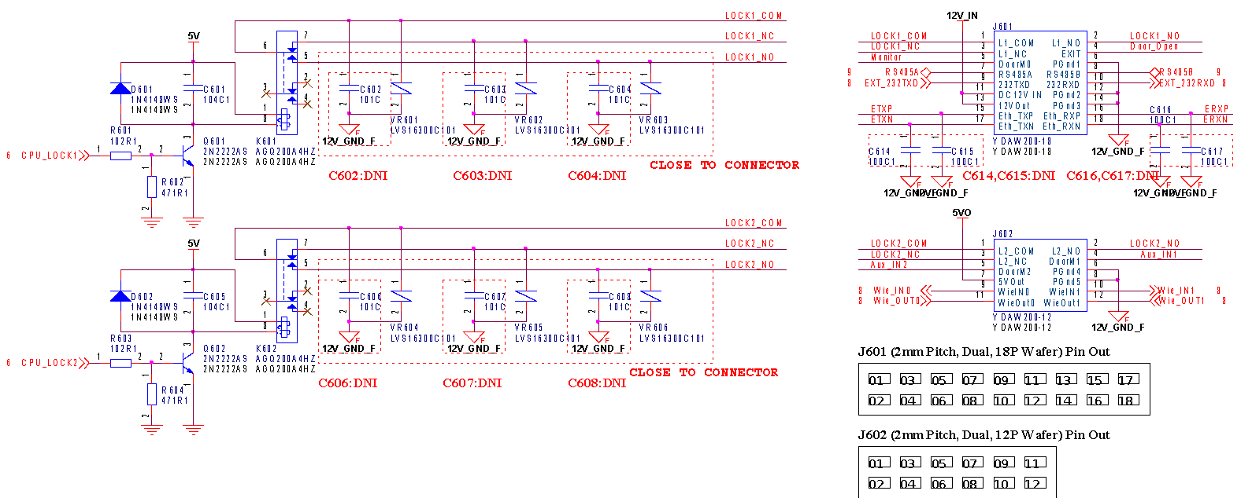
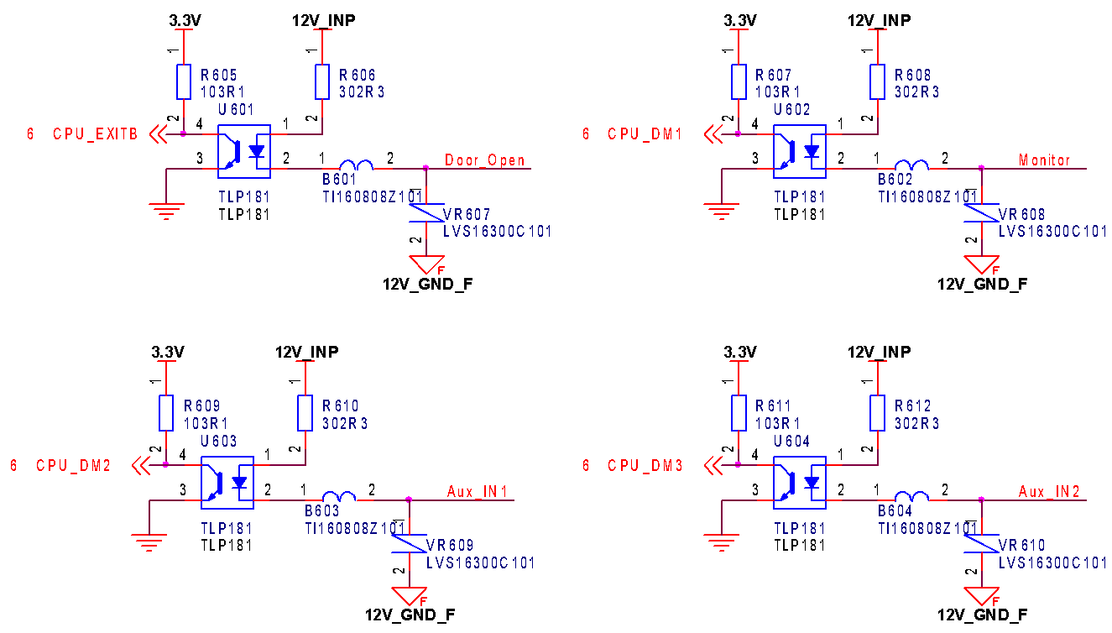
2. Schematic for Door Lock Interface

Slide 4

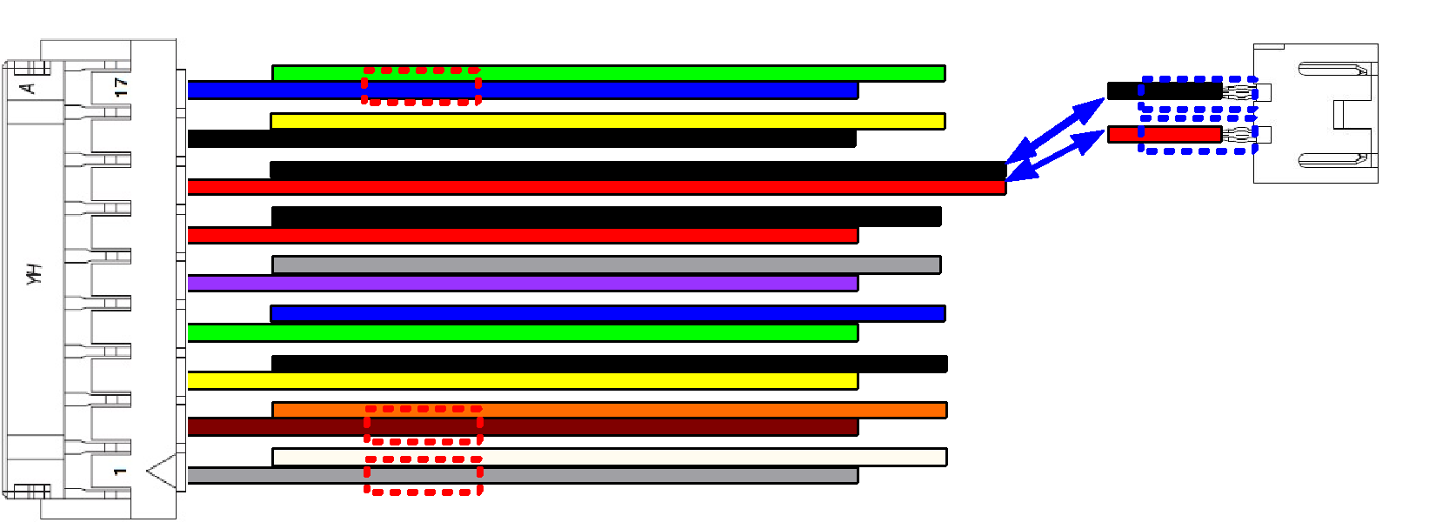
3. Connecting Dead-Bolt Type Door Lock (Fail Safe)
3.1. Connect with One System/ One Lock
Pin1, Pin11 Shorted
Lock(+)
Red
Lock(-)
Black
Pin6, Ground
Gray
Pin3, Lock1 NC
Pin5, Door Monitor
Orange
Pin4, Inside Open
Red
Black
Orange
Gray
: Lock (+)
: Lock (-)
: Door Monitor (NC)
: Ground (Door Status Com)
Inside Door
Open S/W
GND

Slide 5
3. Connecting Dead-Bolt Type Door Lock (Fail Safe)
3.2. Connect with Two Systems/ One Lock
<DB Door Signal>
Closed: NO-COM, Short
NC-COM, Open
Opened: NO-COM, Open
NC-COM, Short
System 2
Lock(+)
Red
Lock(-)
Black
Gray
Pin2, Lock1 NO
Pin1, Lock1 COM
Orange
Red
Black
Orange
Gray
: Lock (+)
: Lock (-)
: Door Monitor (NC)
: Ground (Door Status Com)
System 1
Pin4, Inside Open
Pin6, Ground
Pin5, Door Monitor
Pin3, Lock1 NC
Pin1, Pin11 Shorted

Slide 6
4. Connecting Strike Type Door Lock (Fail Safe)
4.1. Connect with One system/ One Lock
Pin1, Pin11 Shorted
Pin6, Ground
Lock(-)
Black
Pin3, Lock1 NC
Lock(+)
Red
Pin5, Door Monitor
Yellow
Brown
Pin4, Inside Open
Inside Door
Open S/W
GND

Slide 7
4. Connecting Strike Type Door Lock (Fail Safe)
4.2. Connect with Two systems/ One Lock
System 2
Black
Pin2, Lock1 NO
Red
Yellow
Pin1, Lock1 COM
Brown
System 1
Pin4, Inside Open
Pin6, Ground
Pin5, Door Monitor
Pin3, Lock1 NC
Pin1, Pin11 Shorted

Slide 8
5. Connecting Strike Type Door Lock (Fail Secure)
5.1. Connect with One system/ One Lock
Pin1, Pin11 Shorted
Pin6, Ground
Lock(-)
Black
Pin2, Lock1 NO
Lock(+)
Red
Pin5, Door Monitor
Yellow
Brown
Pin4, Inside Open
Inside Door
Open S/W
GND

Slide 9
5. Connecting Strike Type Door Lock (Fail Secure)
5.2. Connect with Two systems/ One Lock
System 2
Black
Pin2, Lock1 NO
Red
Yellow
Brown
System 1
Pin4, Inside Open
Pin6, Ground
Pin5, Door Monitor
Pin2, Lock1 NO
Pin1, Pin11 Shorted

Slide 10
6. Connecting EM Type Door Lock (Fail Safe)
6.1. Connect with One system/ One Lock
<EM Door Signal>
Closed: NO-COM, Short
NC-COM, Open
Opened: NO-COM, Open
NC-COM, Short
Pin1, Pin11 Shorted
Pin6, Ground
Lock(-)
(-)Black
Pin3, Lock1 NC
Lock(+)
(+)Red
Pin5, Door Monitor
Door Signal: NC
Pin4, Inside Open
Inside Door
Open S/W
GND

Slide 11
6. Connecting EM Type Door Lock (Fail Safe)
6.2. Connect with Two System/ One Lock
System 2
(-)Black
Pin2, Lock1 NO
(+)Red
Door Signal: NC
Pin1, Lock1 COM
System 1
Pin4, Inside Open
Pin6, Ground
Pin5, Door Monitor
Pin3, Lock1 NC
Pin1, Pin11 Shorted

Slide 12
6. Connecting EM Type Door Lock (Fail Safe)
6.3. Connect with One system/ Two Locks ** Use external DC Power adapter
Lock 1
Pin6, Ground
(-)Black
Pin5, Door Monitor
Pin3, Lock1 NC
Door Signal: NC
(+)Red
Inside Door
Open S/W
12V 3A
Adapter
External
(+)
(-)
GND
Pin4, Inside Open
Lock 2

Slide 13
7. Connecting Auto-Door (Contact Control)
7.1. Connect with One system/ One Door
Auto Door Operating Part
Auto Door Motor
Auto-Door Sensor
Auto-Door Monitor
Sensor Input Line
9P CONN
Pin4, Inside Open
Pin2, Lock1 NO
GND
Pin1, Lock1 COM
Inside Door
Open S/W

Slide 14
7. Connecting Auto-Door (Contact Control)
7.2. Connect with Two systems/ One Door
Auto Door Operating Part
Auto Door Motor
Auto-Door Monitor
Sensor Input Line
9P CONN
Auto-Door Sensor
Pin2, Lock1 NO
Pin1, Lock1 COM
Pin2, Lock1 NO
Pin1, Lock1 COM

Slide 15
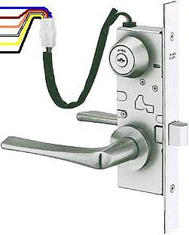
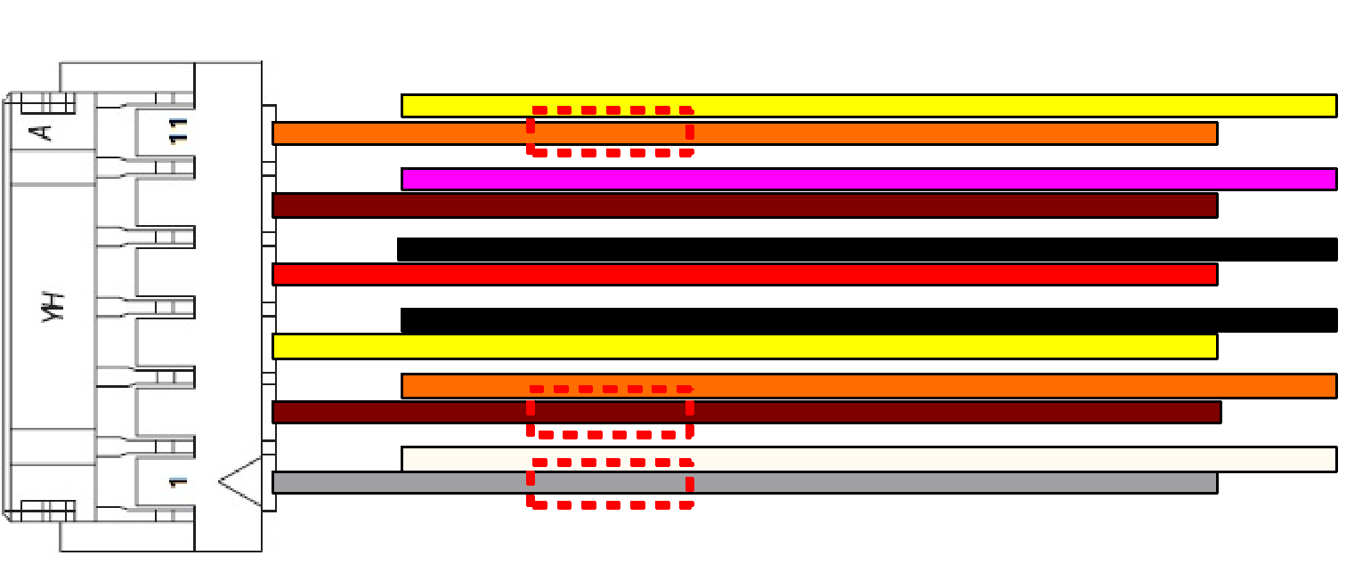
8. Connecting Motorised Lock
8.1. Connect with Motor Lock
Blue
Brown
Orange
White
Yellow
Black
Red
: Motor 2
: Motor 1
: Door Monitor(NO)
: Ground
: Lock NC Signal
: Ground
: Lock NO Signal
Pin5, Aux IN2
Pin4, Aux IN1
Pin2(L2NO), below Pin11 Shorted
Pin3(L2NC), below Pin6 Shorted
Pin1, Lock2 COM
Pin6, Ground
Pin5, Door Monitor
Pin2(L1NO), Pin11 Shorted
Pin3(L1NC), Pin6 Shorted
Pin1, Lock1 COM
Pin4, Door Open
Inside Door
Open S/W
** Motor Lock SPEC. : U9AL3MHD (DC24/0.3A).
** Select motor lock 1st in the Lock setting at the menu.

Slide 16


9. Connecting 2 Emergency Lamps
Emergency
Lamp 1
Emergency
Lamp 2
12 V (+)
Ground (-)
12 V (+)
Ground (-)
Pin2, Lock2 NO
Lock 2 (+)
Pin1, below Pin11 Short
Lock(-)
Pin2, Lock1 NO
Lock 1 (+)
Pin1, Pin11 Shorted

Slide 17
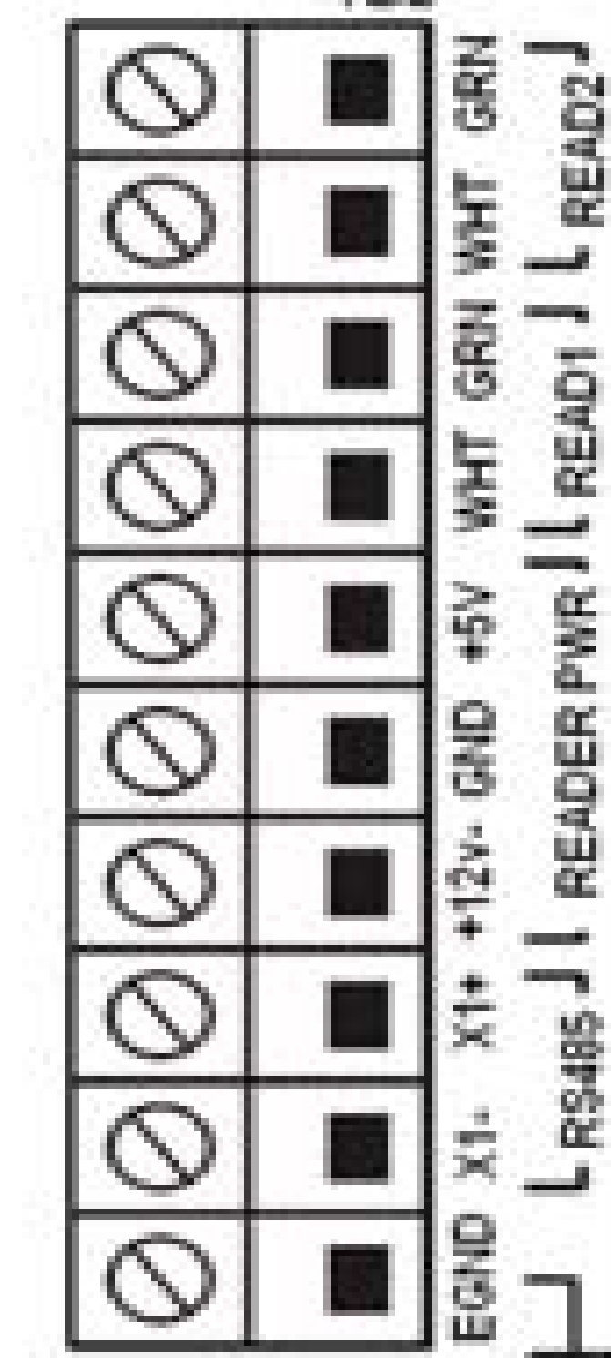
10. Connecting Wiegand Output to External Controller
Pin11, Wiegand Out0
Data 0
Pin12, Wiegand Out1
Data 1
Pin8, Ground
GND
External Access Controller Input
Supported Formats
-26 bits
-34 bits
(Site Code + User ID) = User Card number for controller

Slide 18
11. Appendix
11.1 RS-232 Interface
Pin12, Ground
Pin10, RS232 RXD (IN)
Pin9, RS232 TXD (OUT)

Slide 19

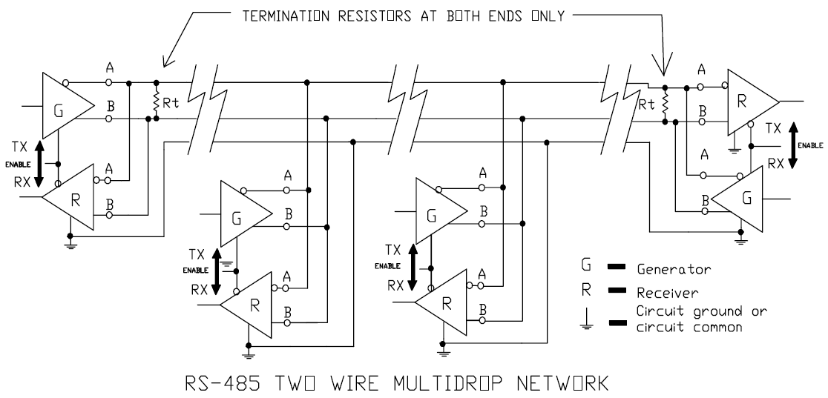
11. Appendix
11.2 RS-485 Interface
Pin8, RS485 B
120ohm Resistor
Pin7, RS485 A
** When you need a termination resistor, connect 120ohm Resistor
between RS485A and RS485B.

Slide 20
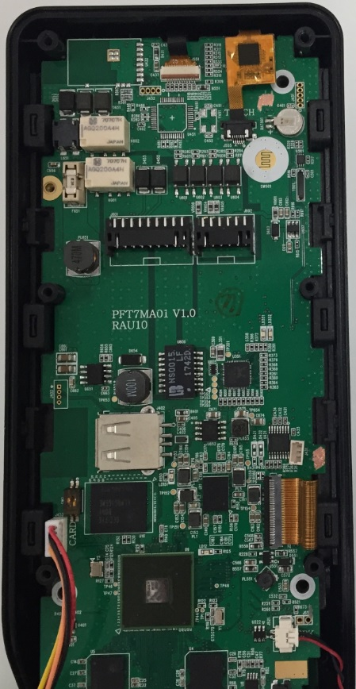
11. Appendix
11.3 WIFI Dongle Insert after assembly
D
** Open the Bottom cover.
Unlock the camera connector & pull out the cable in position A.
Unlock the touch screen connector & pull out the cable in position B.
Loosen the six angle screw boss in position C.
Loosen the screws in position D, E, F.
Insert the WIFI Dongle in position G after pull up the left side of Main PBA.
And then re-assemble in reverse order.
A
B
C
G
F
E

Slide 21
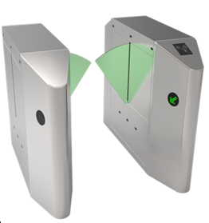
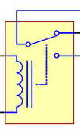
11. Appendix
11.4 How to connect an external relay
** It is recommended to connect an external relay if a problem occurs after connection with
an external equipment such as a speed gate.
Pin1, Pin11 Shorted
Pin6, Ground
Pin2, Lock1 NO
External Relay
<Relay SPEC.>
Coil Voltage: 12V
Contact Current: 1A~2A

Slide 22
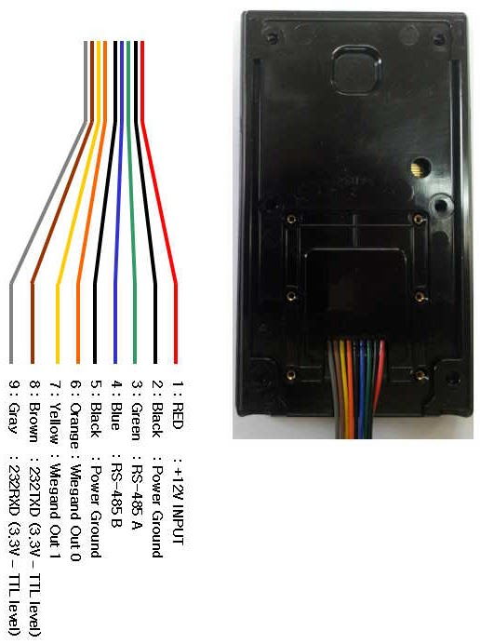
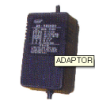
11. Appendix
11.5 How to connect the VS-R20D RF Dummy Card Reader
SW51 Select S/W
1 2 3 4 5 6
ON [1]
OFF [0]
* 1, 2, 3 OFF: 26Bit
* 4 ON: Wiegand Mode
Adapter
Pin10, Wie IN 1, Pink
Pin9, Wie IN 0, Brown
Pin8, GND, Black

Slide 23
11. Appendix
11.5 How to connect the VS-R20D SC Dummy Card Reader
SW51 Select S/W
1 2 3 4 5 6
ON [1]
OFF [0]
* 1, 2, 3 ON: 34Bit
* 4 ON: Wiegand Mode
Adapter
Pin10, Wie IN 1, Pink
Pin9, Wie IN 0, Brown
Pin8, GND, Black

Slide 24

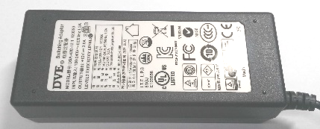
11. Appendix
11.6 The maximum cable length & thickness for installation
1) Using 12V 3.5A Power Supply & AWG24
AWG24 15m
AWG24 10m
Dead-Bolt
BEHOST BHL-700C
(Standby:0.15A, Start:0.9A)
12V 3.5A Adapter
UBio-X Slim
2) Using 12V 3.5A Power Supply & AWG22
AWG22 25m
AWG22 10m
Dead-Bolt
BEHOST BHL-700C
(Standby:0.15A, Start:0.9A)
12V 3.5A Adapter
UBio-X Slim
* Caution: The above data are the measured values when using the adapters and the dead-bolts provided by the Union Community.

Slide 25
11. Appendix
3) Using 12V 3.5A Power Supply & AWG20
AWG20 35m
AWG20 10m
Dead-Bolt
BEHOST BHL-700C
(Standby:0.15A, Start:0.9A)
12V 3.5A Adapter
UBio-X Slim
* Caution: The above data are the measured values when using the adapters and the dead-bolts provided by the Union Community.

Slide 26





12. Wiring Guide
12.1 Terminal & Exit Button
Adapter
AWG20 * 2C
AWG22 * 2C
AWG20 * 4C
Server
Door
Switch Hub
CAT. 5-4Pr.(UTP)
CAT. 5-4Pr.(UTP)

Slide 27
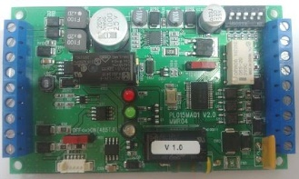
12. Wiring Guide
12.2 Terminal & Exit Button w/Lock Controller
Lock Controller ( ex.BLC-015 )
Adapter
Adapter
AWG20 * 4C
AWG20 * 2C (Power)
AWG22 * 2C
AWG22 * 2C(RS485)
Door
Server
Switch Hub
CAT. 5-4Pr.(UTP)
CAT. 5-4Pr.(UTP)

